Slide 1
Y.E.S. Volunteering Web App
by Rayan Wali
Period 3
Ms. Lorena

Slide 2
High-Level Design
Client
(Browser)
ASP.NET Core Web App
(Web Listener Host/IIS Server)
Database
Email Service
Entity Framework
ASP.NET Core Identity
SQL
Razor Pages
Model
Controller
Filters
Layouts
Startup
CSS

Slide 3
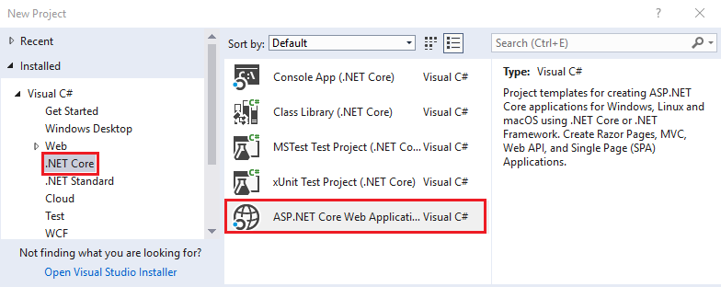
Sequence of Activities - Completed
Installed core application development components including Visual Studio 2017, SQL Server Express, and .Net Framework
Created a Razor Web application using C#:

Slide 4
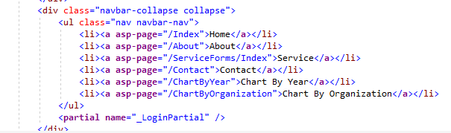
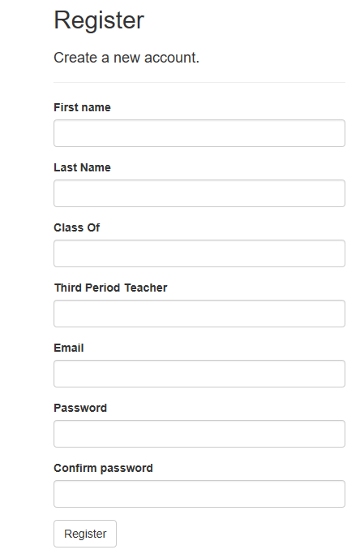
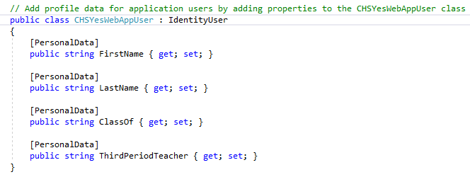
Sequence of Activities - Completed
Shared\_Layout.cshtml
Updated Menu
Extended Identity Provider and Register page to capture additional student information

Slide 5
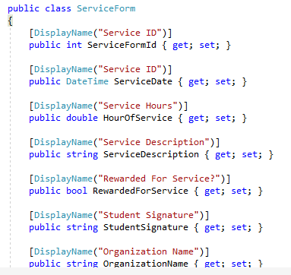
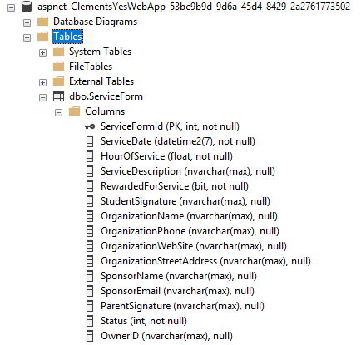

Sequence of Activities - Completed
Created model class for volunteering application form.
Created database from volunteering application form class model.
Package Manager Console

Slide 6
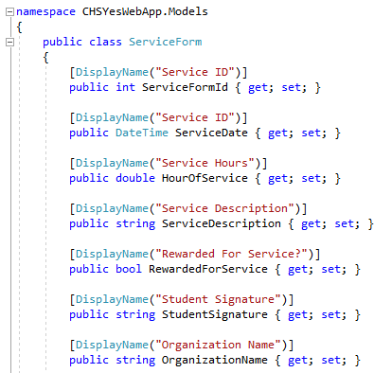
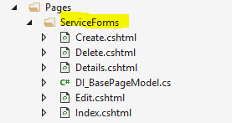
Create, Read, Update, and Delete (CRUD) Operations on Volunteering Form
CRUD operations is implemented using ServiceForm Model class and Entity Framework Database Context that performs database operations.
ServiceForm Model Class
Entity Framework ServiceForm Database Context
CRUD Pages

Slide 7

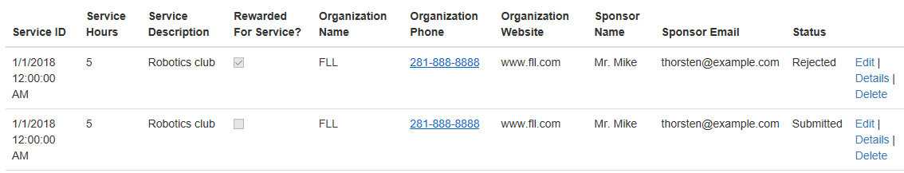
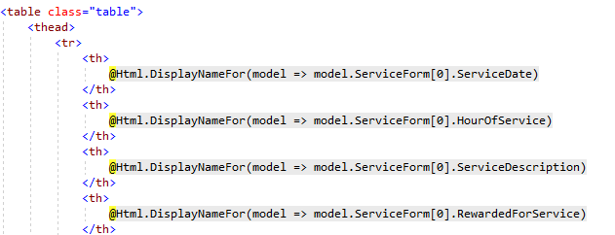
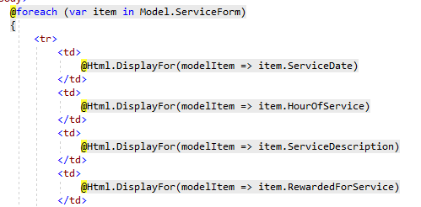
Read Service Form Data
Using database context of Entity Framework, runs database query to get all the service forms data.
Creates HTML Table Header and loops through each ServiceForm
Index.cshtml.cs (code behind)
Index.cshtml (For each collection item of ServiceForm renders output on the page)
Notes:
LINQ Query which is equivalent to Database query e.g. ‘SELECT * FROM ServiceForm’

Slide 8

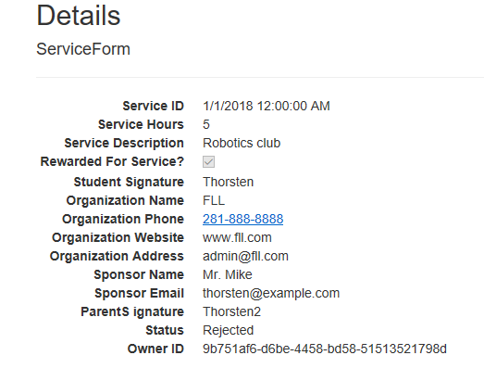
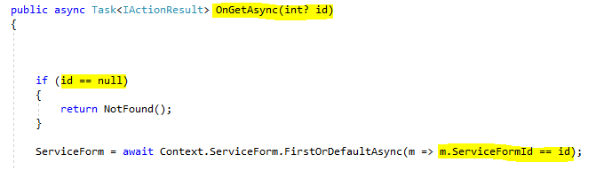
Detail Service Form Data
Click on ‘Details’ for selected ServiceForm from Index.cshtml which routes to Detail.cshtml page.
Opens Detail page with selected ServiceForm ID passed as a parameter.
Index.cshtml
Details.cshtml
Passing Selected ID (2) to Details page
Set Database Context with ID passed and filter the record

Slide 9
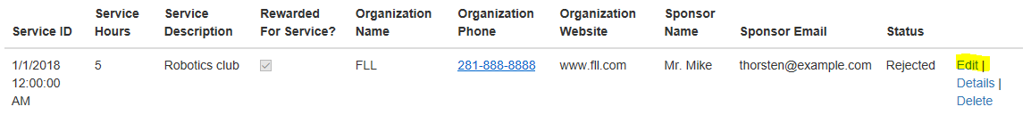
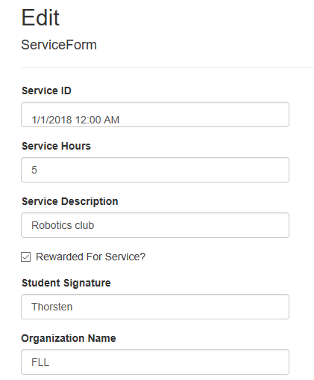
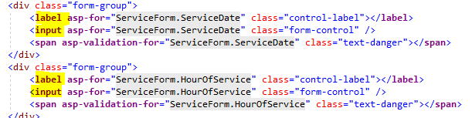
Edit Service Form Data
Click on ‘Edit’ for selected ServiceForm from Index.cshtml route to Edit.cshtml page.
Opens Detail page with selected ServiceForm ID passed as a parameter.
Index.cshtml
Edit.cshtml
Passing Selected ID (2) to Details page
Using Label and Input HTML tag allowing Edit functionality

Slide 10
Edit Service Form Data
Click on ‘Edit’ for selected ServiceForm from Index.cshtml route to Edit.cshtml page.
Opens Edit page with selected ServiceForm ID passed as a parameter.
Index.cshtml
Edit.cshtml
Passing Selected ID (2) to Details page
Using Label and Input HTML tag allowing Edit functionality

Slide 11
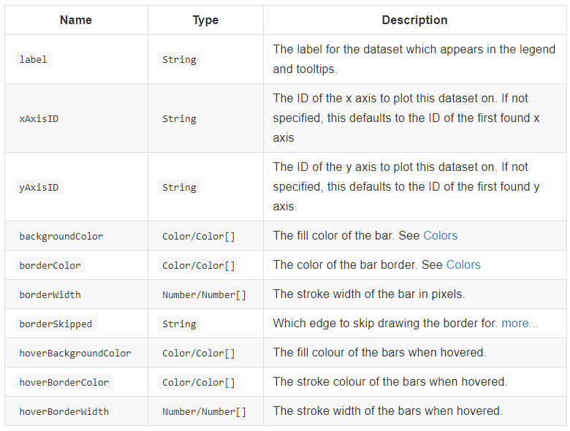
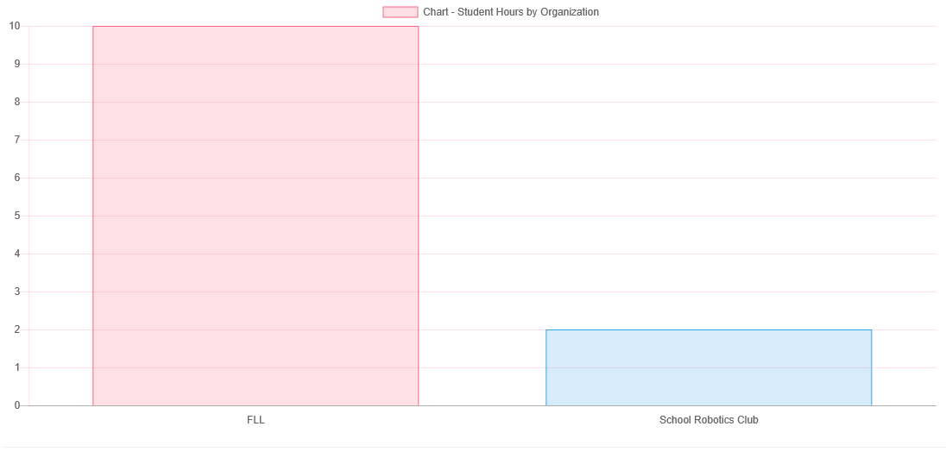
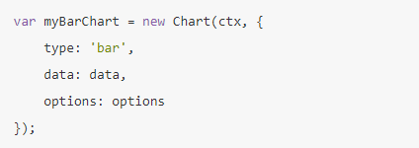
Graph – Volunteering Hours by Organization
Properties of Bar Chart
Used ChartJs open source library for graphs
ChartJs - Bar Chart
Query – Group By Organization
var chartQuery =
from p in Context.ServiceForm
group p by p.OrganizationName into g
Notes:
Use Nuget Package or NPM to install Chart.js which installs Chart.js and add the package reference in the project.

Slide 12
Next Focus
Create reports/graphs
Filtering on form
Search on form
Implement role base security
Approval workflow process

